Slide 1
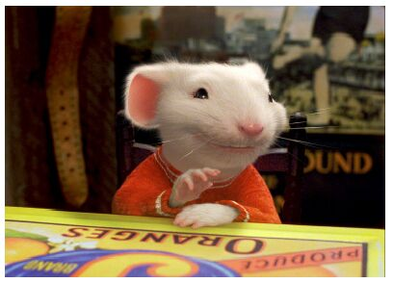
CSE- 4105
Lecture- 07
Transformation-III
2D and 3D Transformation

Slide 2
Reflection
Original position
Reflected position
2
2’
Reflection about the line x=0, the Y- axis , is accomplished with the transformation matrix
1
1’
3
3’
-1 0 0
0 1 0
0 0 1

Slide 3
Reflection
Reflection of an object relative to an axis perpendicular to the xy plane and passing through the coordinate origin
Y-axis
-1 0 0
0 -1 0
0 0 1
Reflected position
3’
2’
1’
The above reflection matrix is the rotation matrix with angle=180 degree.
This can be generalized to any reflection point in the xy plane. This reflection is the same as a 180 degree rotation in the xy plane using the reflection point as the pivot point.
Origin O (0,0)
X-axis
1
2
3
Original position

Slide 4
Reflection
Reflection of an object w.r.t the straight line y=x
0 1 0
1 0 0
0 0 1
Y-axis
Original position
3
2
1
1’
3’
Reflected position
2’
Origin O (0,0)
X-axis

Slide 5
Reflection
Reflection of an object w.r.t the straight line y=-x
Y-axis
0 -1 0
-1 0 0
0 0 1
X-axis
Origin O (0,0)
2
3
Original position
1
1’
2’
Line Y = - X
3’
Reflected position

Slide 6
Shearing
Shear Transformations
Shear is a transformation that distorts the shape of an object such that the transformed shape appears as if the object were composed of internal layers that had been caused to slide over each other.
Two common shearing transformations are those that shift coordinate x values and those that shift y values.

Slide 7
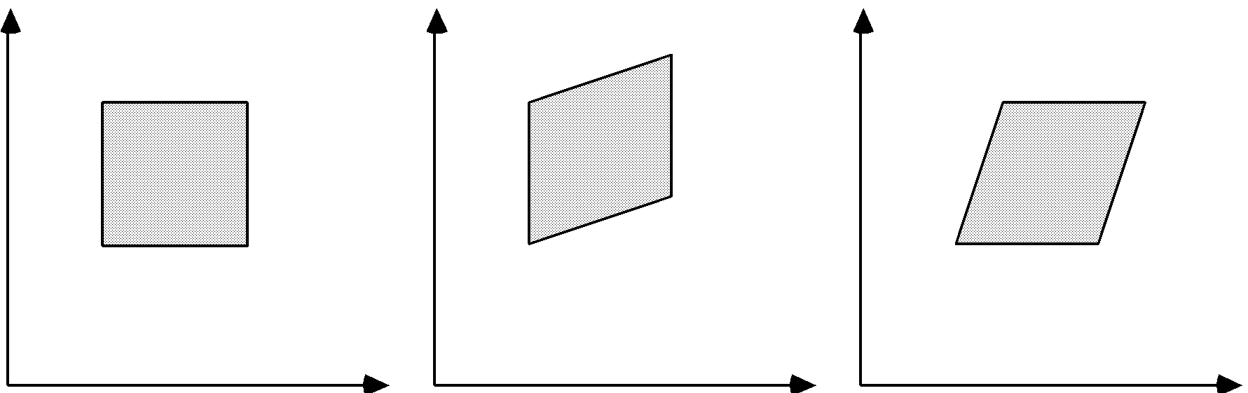
Shearing
Shears
Original Data y Shear x Shear

Slide 8
Shearing
An X- direction Shear
For example, Sh_{x}=2
(2,1)
(3,1)
(0,1)
(1,1)
(0,0)
(1,0)
(0,0)
(1,0)

Slide 9
Shearing
An Y- direction Shear
For example, Sh_{y}=2
Y
Y
(1,3)
(1,2)
(0,1)
(1,1)
(0,1)
X
X
(0,0)
(1,0)
(0,0)

Slide 10
3D TRANSFORMATION

Slide 11
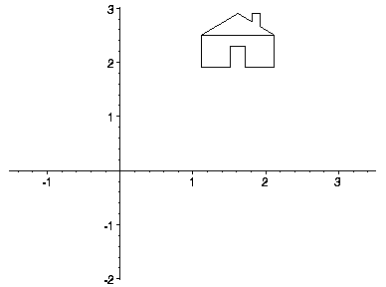
Transformation
Transformations are a fundamental part of the computer graphics. Transformations are the movement of the object in Cartesian plane .

Slide 12
Types of Transformation
There are two types of transformation in computer graphics.
1) 2D transformation
2) 3D transformation
Types of 2D and 3D transformation
1) Translation
2) Rotation
3) Scaling
4) Shearing
5) Mirror reflection

Slide 13
Uses of Transformation
Transformation are used to position objects , to shape object , to change viewing positions , and even how something is viewed.
In simple words transformation is used for
1) Modeling
2) viewing

Slide 14
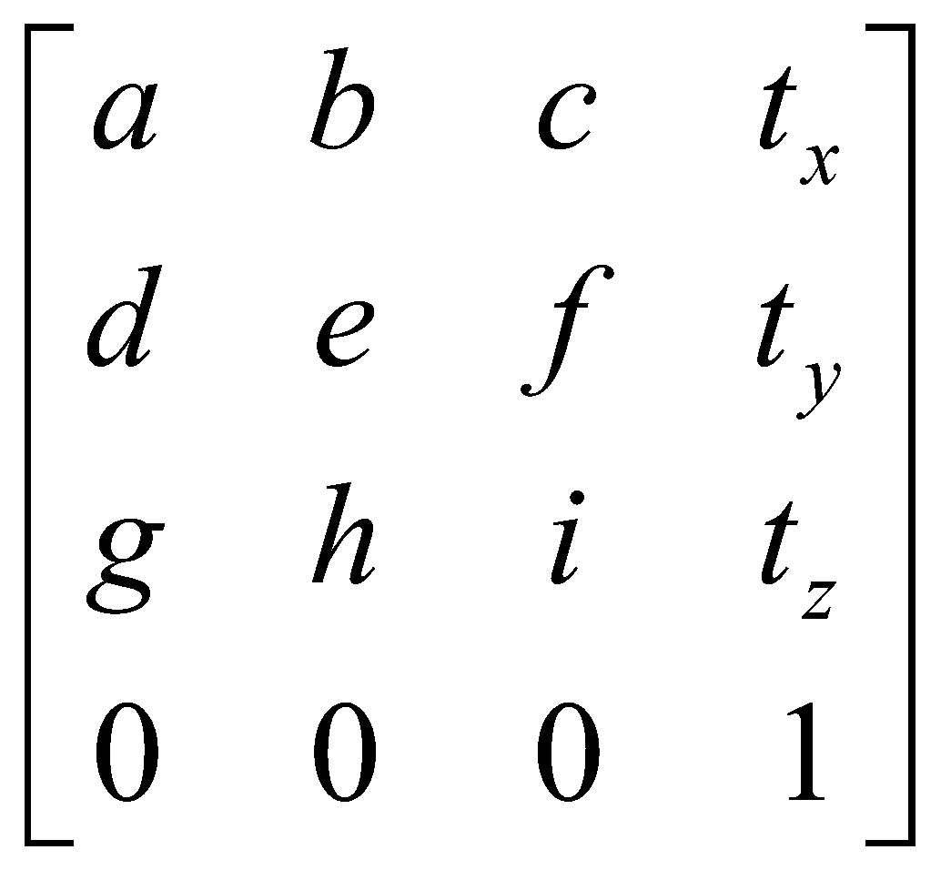
3D Transformation
When the transformation takes place on a 3D plane, it is called 3D transformation.
Generalize from 2D by including z coordinate
Straight forward for translation and scale, rotation more difficult
Homogeneous coordinates: 4 components
Transformation matrices: 4×4 elements

Slide 15
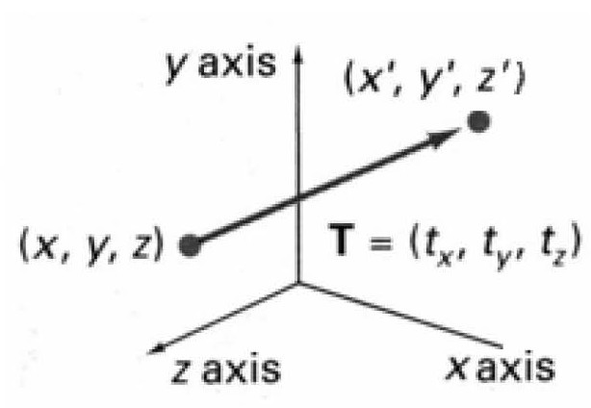
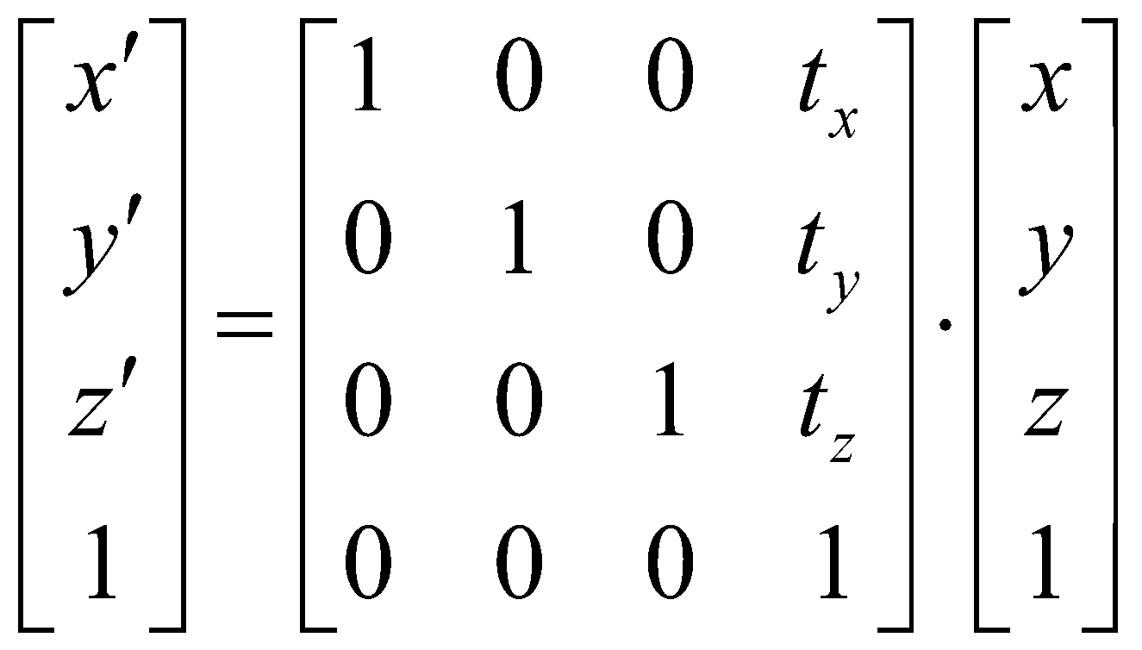
3D Translation
Moving of object is called translation.
In 3 dimensional homogeneous coordinate representation , a point is transformed from position P = ( x, y , z) to P’=( x’, y’, z’)
This can be written as:-
Using P’ = T . P

Slide 16
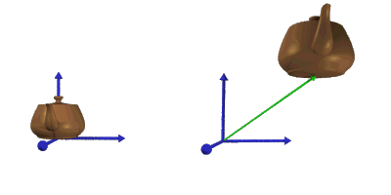
3D Translation
The matrix representation is equivalent to the three equation.
x’=x+ t_{x} , y’=y+ t_{y} , z’=z+ t_{z}
Where parameter t_{x ,} t_{y ,} t_{z} are specifying translation distance for the coordinate direction x , y , z are assigned any real value.

Slide 17
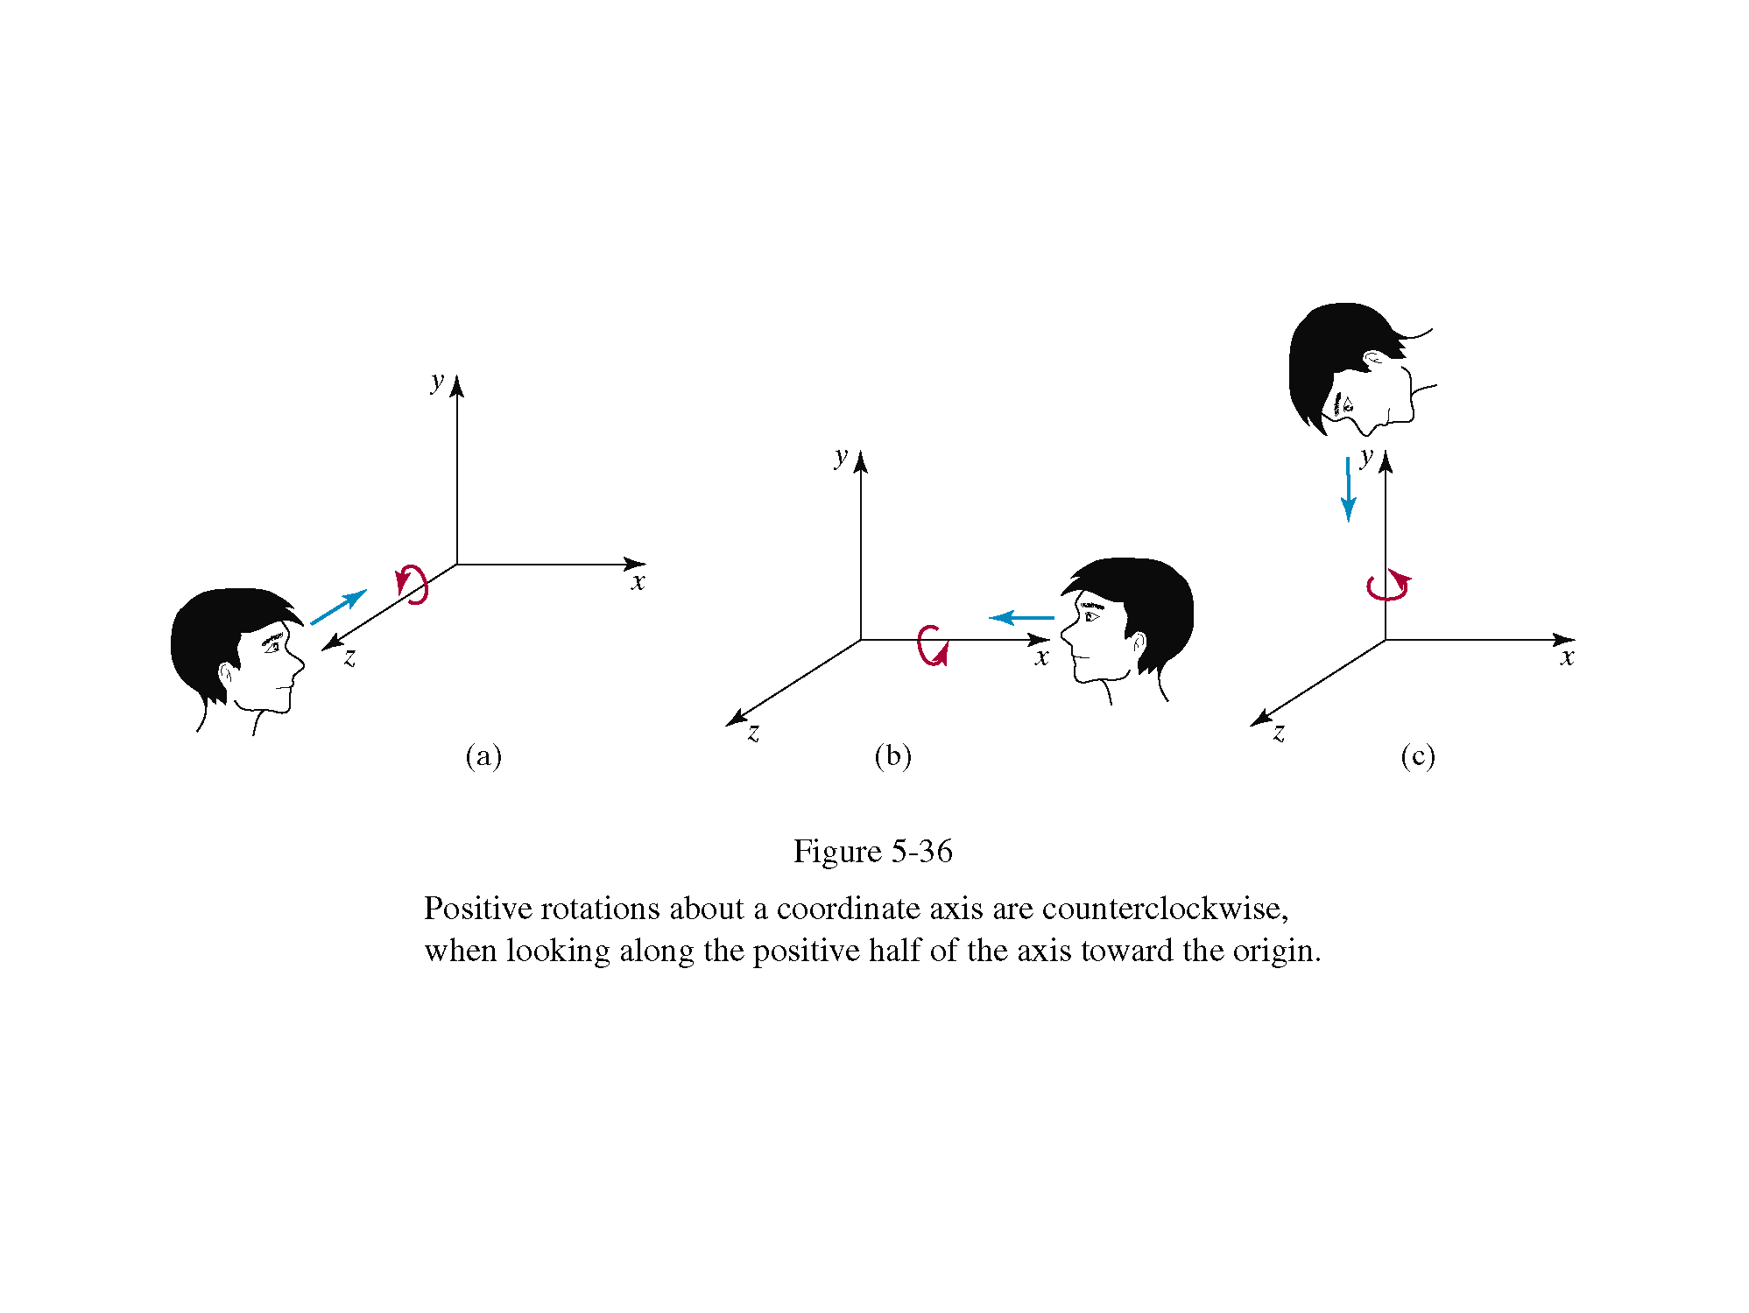
3D Rotation
Where an object is to be rotated about an axis that is parallel to one of the coordinate axis, we can obtain the desired rotation with the following transformation sequence.
Coordinate axis rotation
Z- axis Rotation(Roll)
Y-axis Rotation(Yaw)
X-axis Rotation(Pitch)

Slide 18
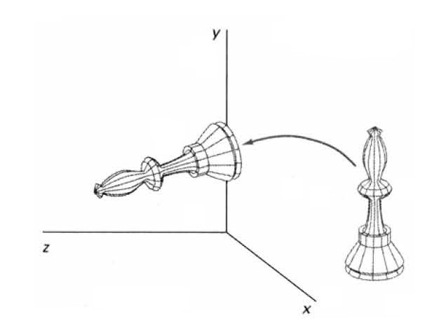
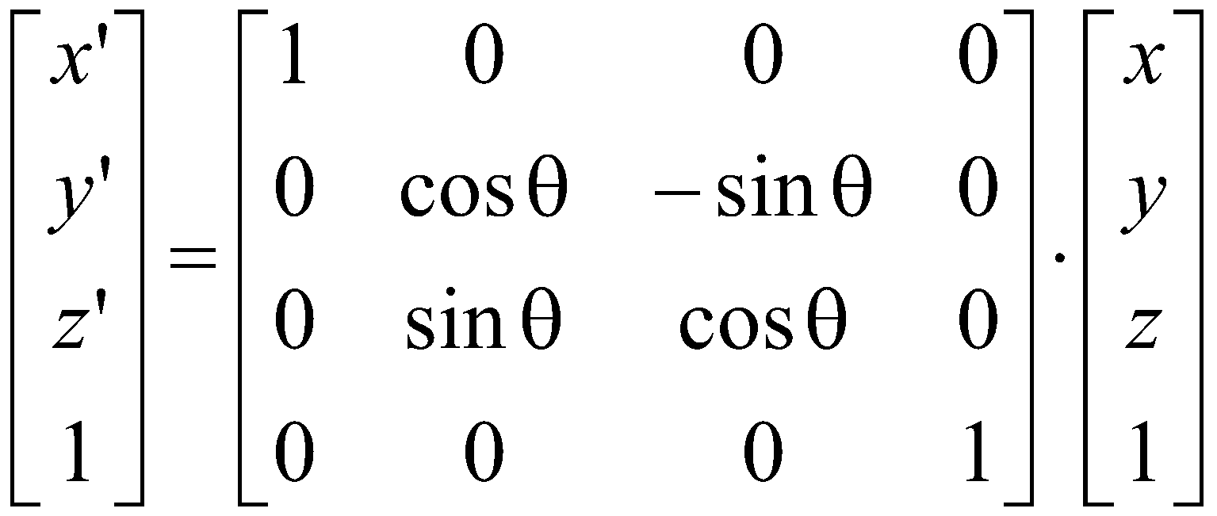
X-Axis Rotation
The equation for X-axis rotation
x’ = x
y’ = y cosθ – z sinθ
z’ = y sinθ + z cosθ

Slide 19
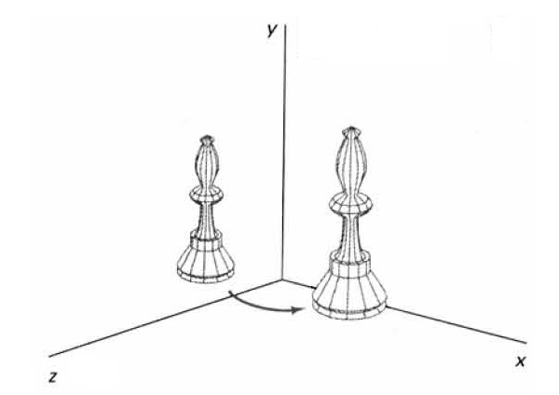
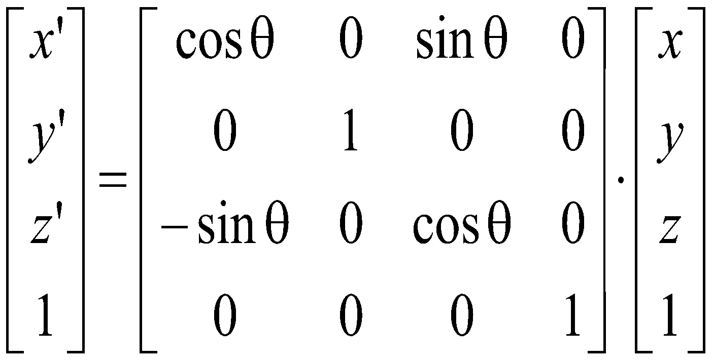
Y-Axis Rotation
The equation for Y-axis rotation
x’ = x cosθ + z sinθ
y’ = y
z’ = z cosθ - x sinθ

Slide 20
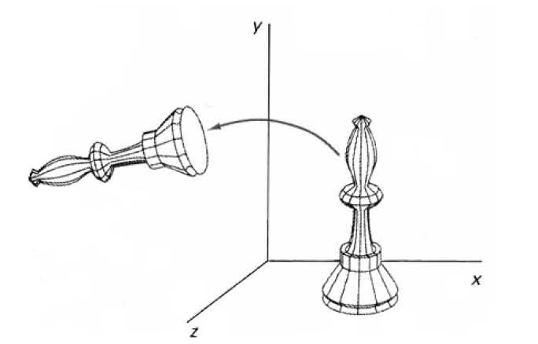
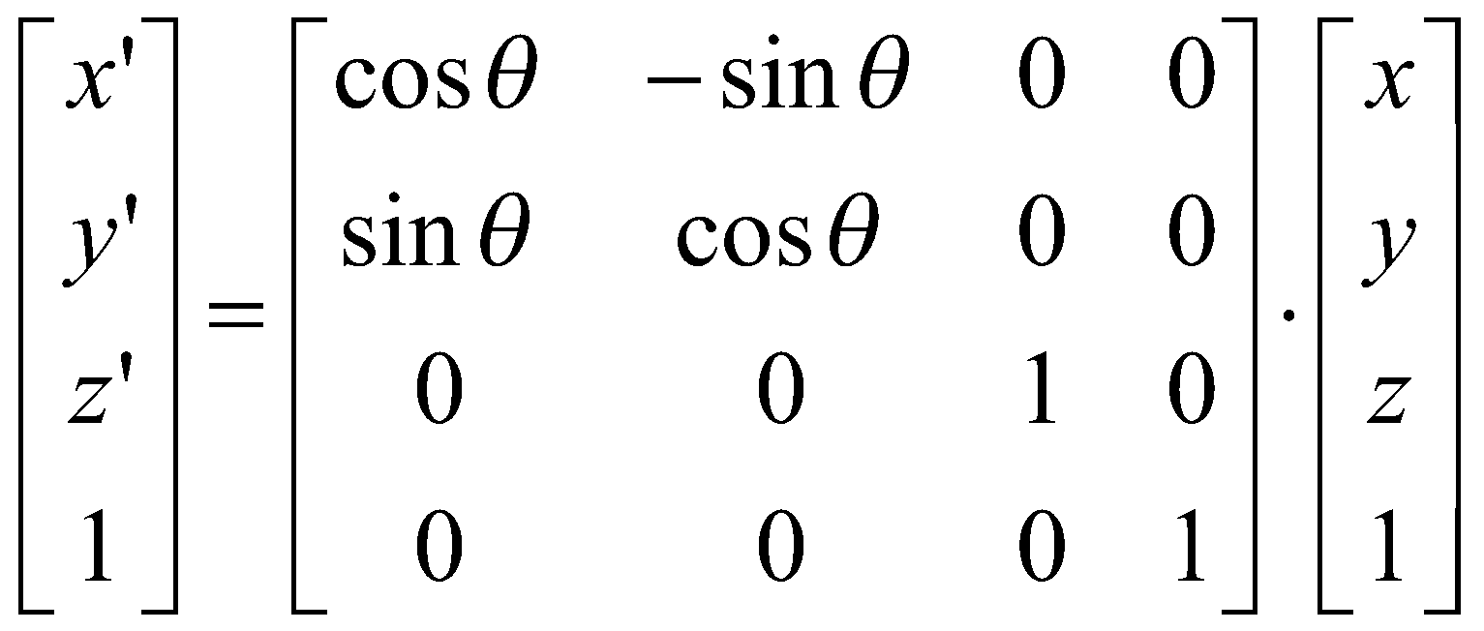
Z-Axis Rotation
The equation for Z-axis rotation
x’ = x cosθ – y sinθ
y’ = x sinθ + y cosθ
z’ = z

Slide 21
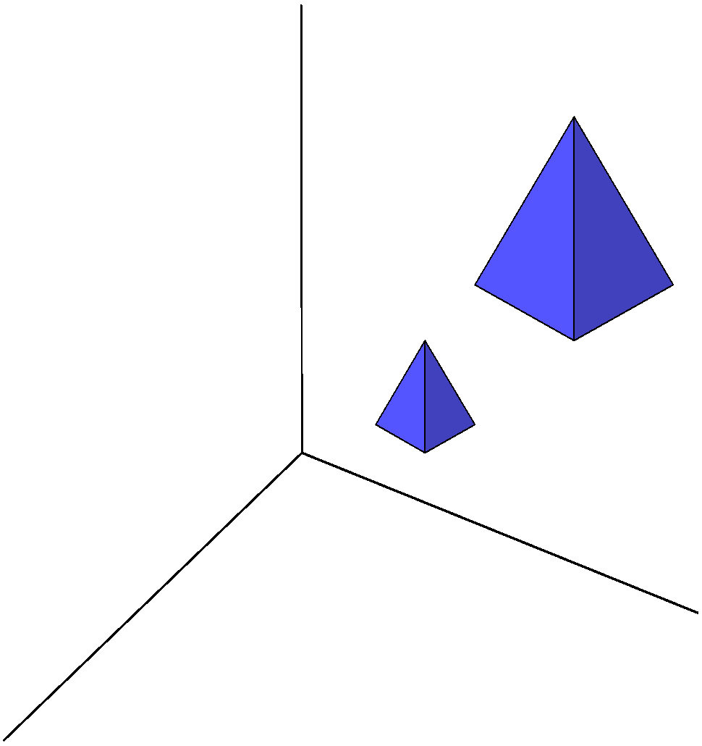
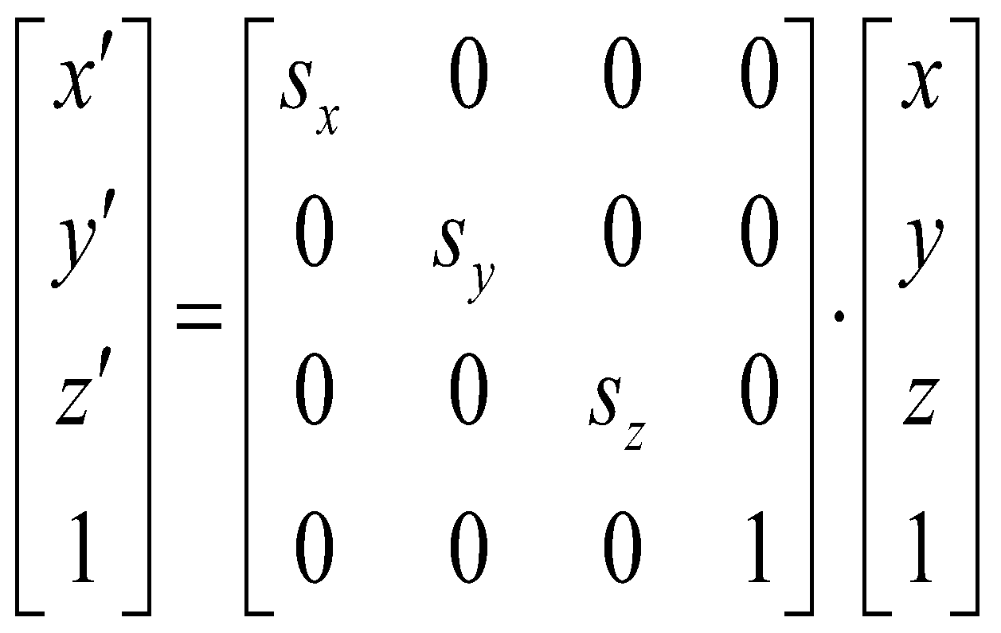
3D Scaling
Changes the size of the object and repositions the object relative to the coordinate origin.

Slide 22
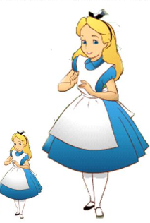
3D Scaling
The equations for scaling
x’ = x . sx
S_{sx,sy,sz} ➔ y’ = y . sy
z’ = z . sz

Slide 23

3D Reflection
Reflection in computer graphics is used to emulate reflective objects like mirrors and shiny surfaces
Reflection may be an x-axis
y-axis , z-axis and also in
the planes xy-plane,yz-plane , and
zx-plane.
Reflection relative to a given
Axis are equivalent to 180
Degree rotations

Slide 24
3D Reflection
Reflection about x-axis:-
x’=x y’=-y z’=-z
1 0 0 0
0 -1 0 0
0 0 -1 0
0 0 0 1
Reflection about y-axis:-
y’=y x’=-x z’=-z

Slide 25
3D Reflection
The matrix for reflection about y-axis:-
-1 0 0 0
0 1 0 0
0 0 -1 0
0 0 0 1
Reflection about z-axis:-
x’=-x y’=-y z’=z
-1 0 0 0
0 -1 0 0
0 0 1 0
0 0 0 1

Slide 26
3D Shearing
Modify object shapes
Useful for perspective projections
When an object is viewed from different directions and at different distances, the appearance of the object will be different. Such view is called perspective view. Perspective projections mimic what the human eyes see.

Slide 27
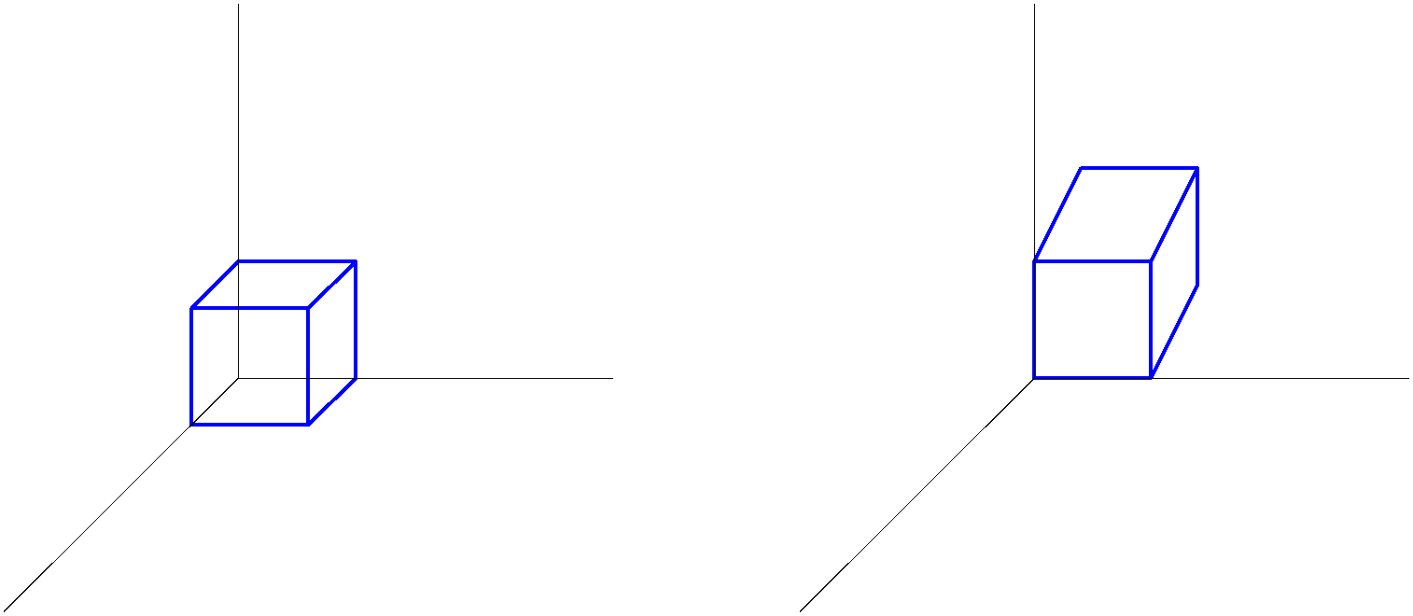
3D Shearing

Slide 28
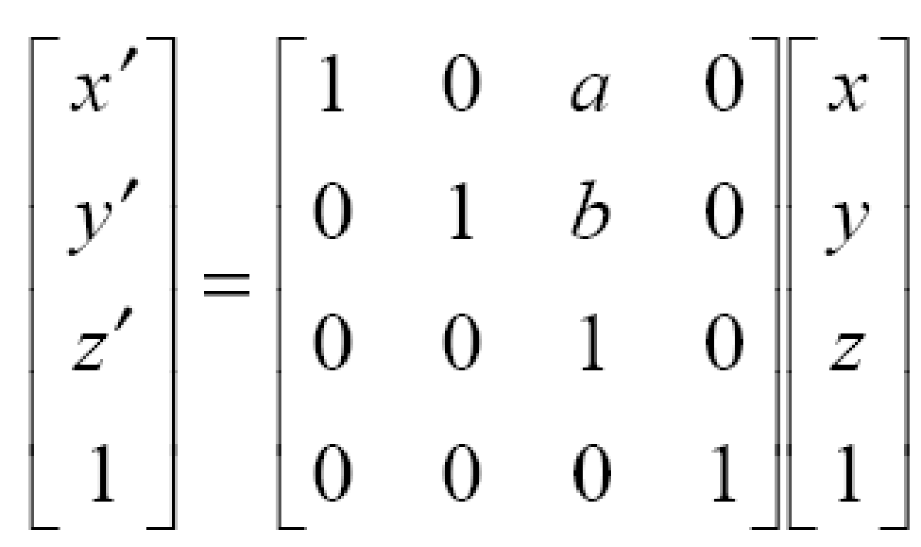
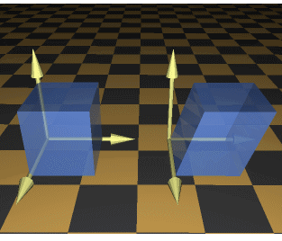
3D Shearing
Matrix for 3d shearing
Where a and b can
Be assigned any real
Value.

Slide 29
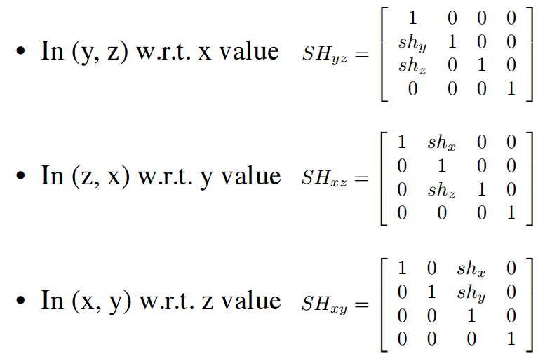
3D Shearing

Slide 30
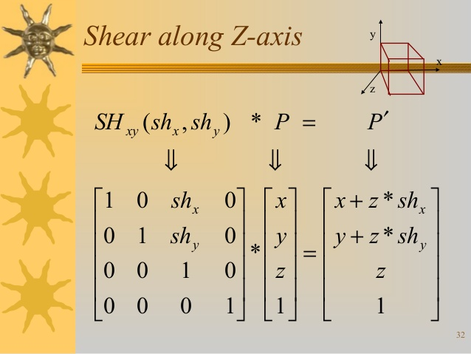
3D Shearing

Slide 31
Thank You

